Slide 1

What we learned last time …
Definition: $H=U+PV$
Differential Equations of State:
$dH=C_{P}dT+μ_{T}dP$ (like $dU=C_{V}dT+π_{T}dV$)
Calorimetry:
$dH=dq_{P}$ and $∆H=q_{P}$ (like $dU=dq_{V}$ and $∆U=q_{V}$)
Heat capacities
$C_{P}=C_{V}+nR$ for ideal gases, $C_{P}≈C_{V}+nR$ for real gases
Inversion temperature:
$μ_{T}$ $<0$ at low T, $>0$ at high T, and $=0$ at the inversion temperature
How to recognize $T_{inv}$ by inspecting $H(T,P)$
U(T,V)
V
T
H(T,P)
P
T

Slide 2
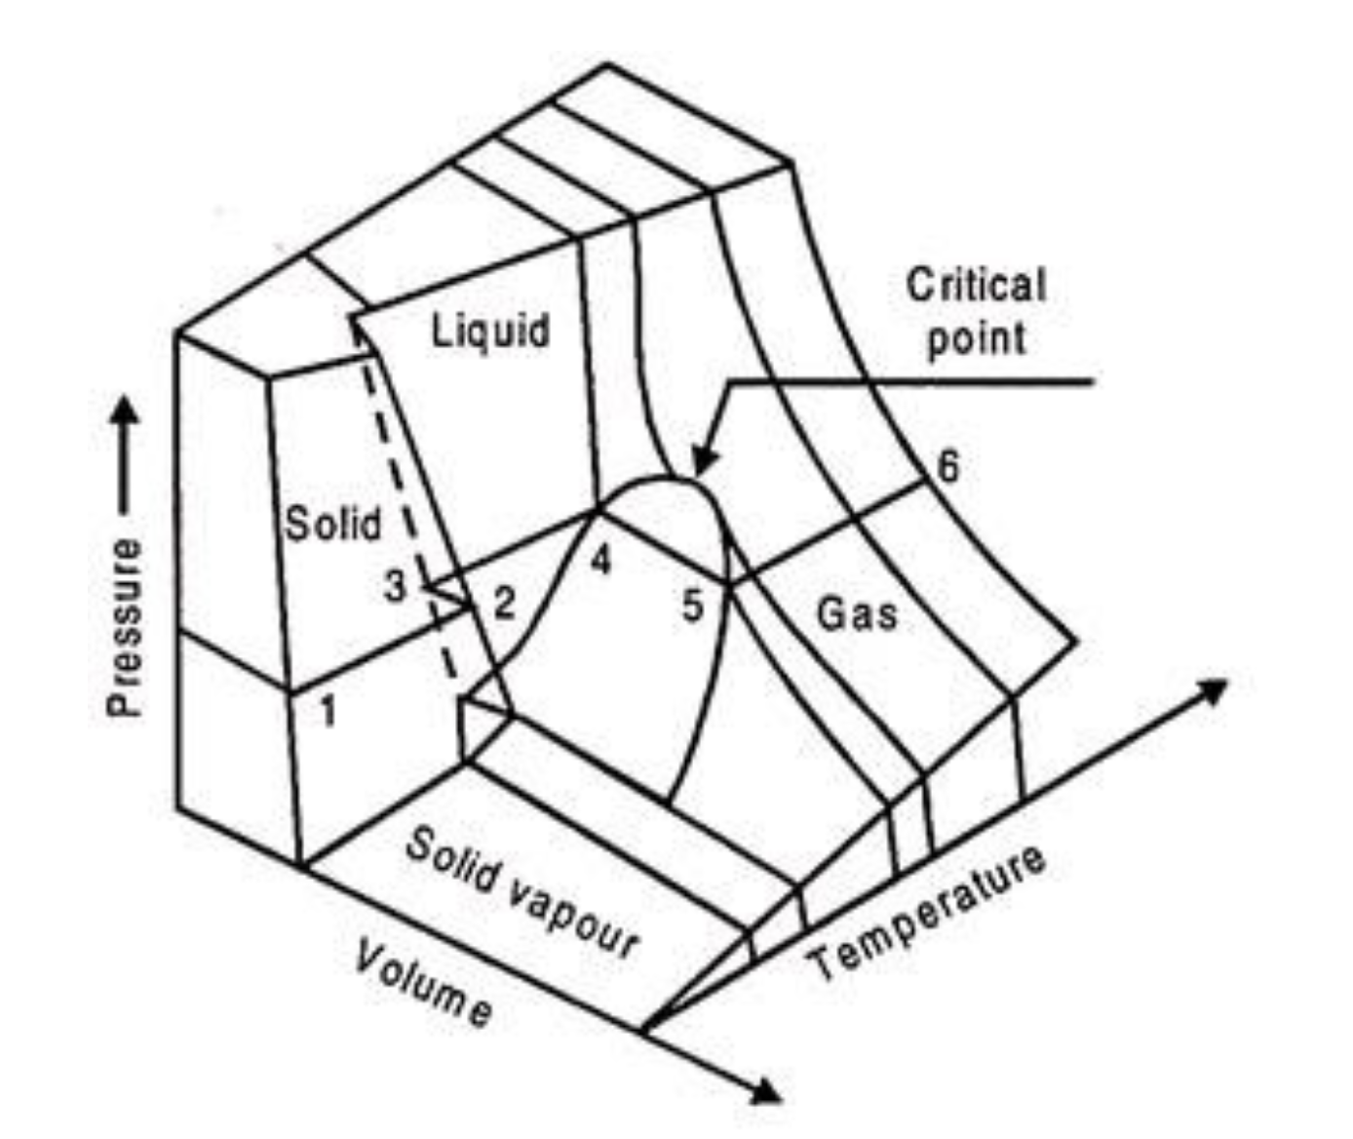
What all gases/liquids/solids do
The Principle of Corresponding States says all substances do this, just at different temperatures and volumes
https://www.engineeringenotes.com/thermal-engineering/real-gases/real-gases-properties-van-der-waals-equation-and-equation-of-state-thermal-engineering/49112

Slide 3
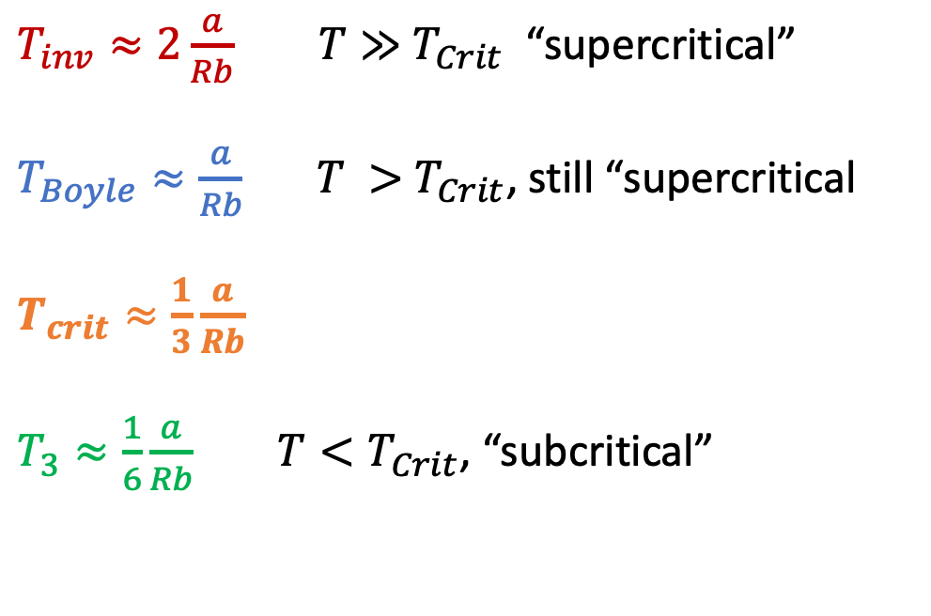
Relationships between these temperatures
$T_{inv}≈2\frac{a}{Rb}$ $T≫{ T}_{Crit}$ “supercritical”
$T_{Boyle}≈\frac{a}{Rb}$ $T >{ T}_{Crit}$, still “supercritical
$T_{crit}≈\frac{1}{3}\frac{a}{Rb}$
$T_{3}≈\frac{1}{6}\frac{a}{Rb}$ $T<T_{Crit}$, “subcritical”
https://www.engineeringenotes.com/thermal-engineering/real-gases/real-gases-properties-van-der-waals-equation-and-equation-of-state-thermal-engineering/49112

Slide 4


How you can tell if a gas is supercritical or subcritical
Isothermal compression below and above the critical temperature
$$T<T_{c}$$
$$T>T_{c}$$
gas
gas
Super-critical Gas/
Liquid
gas
liquid
liquid
liquid

Slide 5
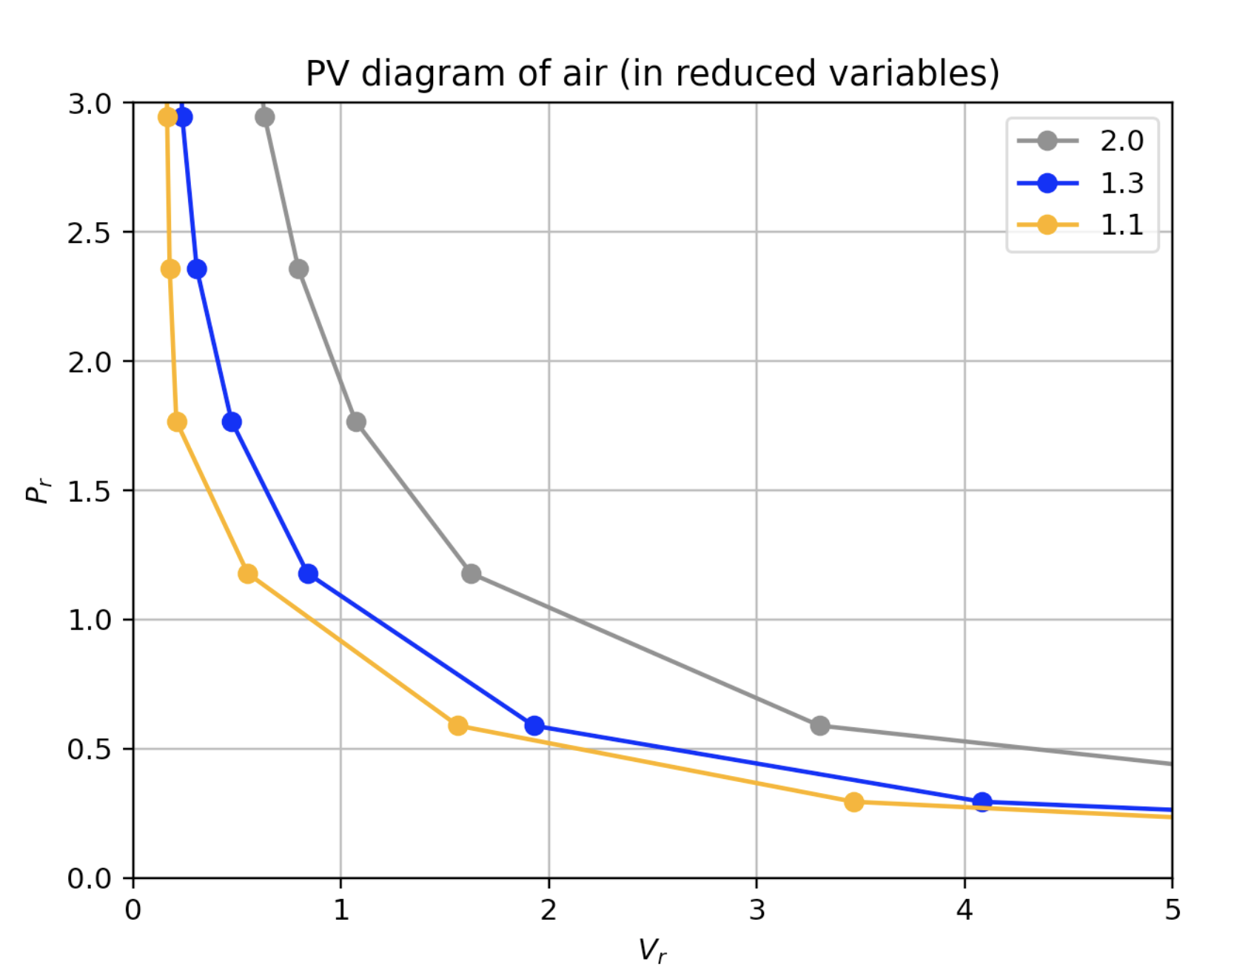
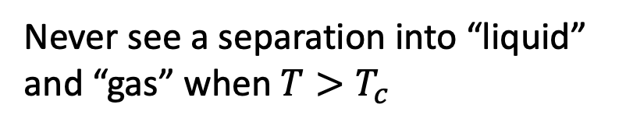
How you can tell if a gas is supercritical or subcritical
$$T>T_{c}$$
Never see a separation into “liquid” and “gas” when $T>T_{c}$
gas
Super-critical Gas/
Liquid
liquid

Slide 6

How you can tell if a gas is supercritical or subcritical
$$T>T_{c}$$
Never see a separation into “liquid” and “gas” when $T>T_{c}$
gas
Super-critical Gas/
Liquid
liquid

Slide 7
Approaching 𝑻_{𝒄rit} from above
$$T>T_{c}$$
But there’s a hint of something afoot: along colder isotherms, P(V) gets flatter and flatter.
gas
Super-critical Gas/
Liquid
liquid

Slide 8
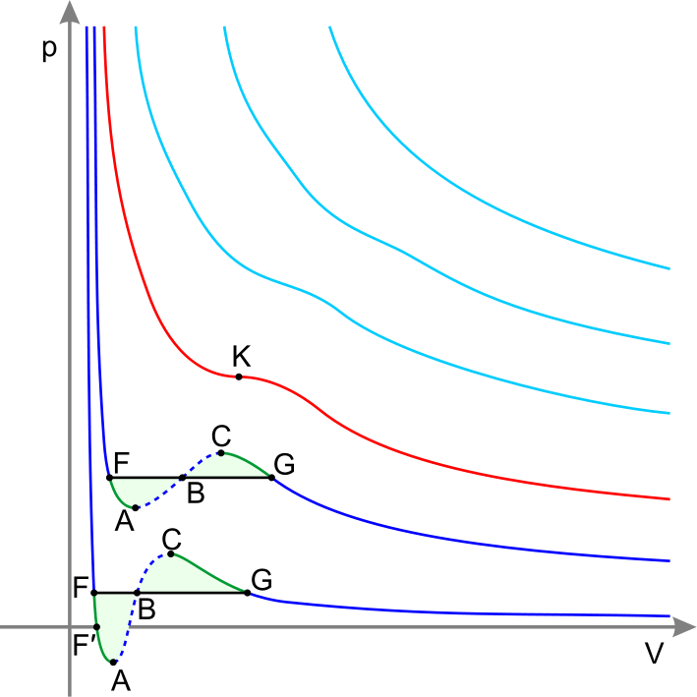


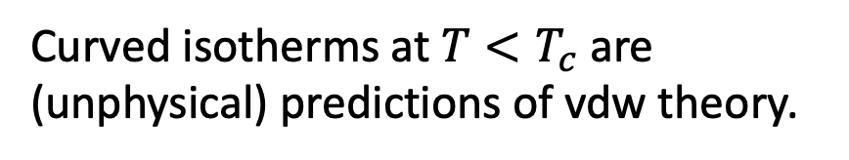
van der Waals formula actually does a good job when 𝑻>𝑻_{𝒄rit}
Isothermal compression in an indicator diagram
$$T>T_{c}$$
$$T=T_{c}$$
T_{crit}
Curved isotherms at $T<T_{c}$ are (unphysical) predictions of vdw theory.

Slide 9
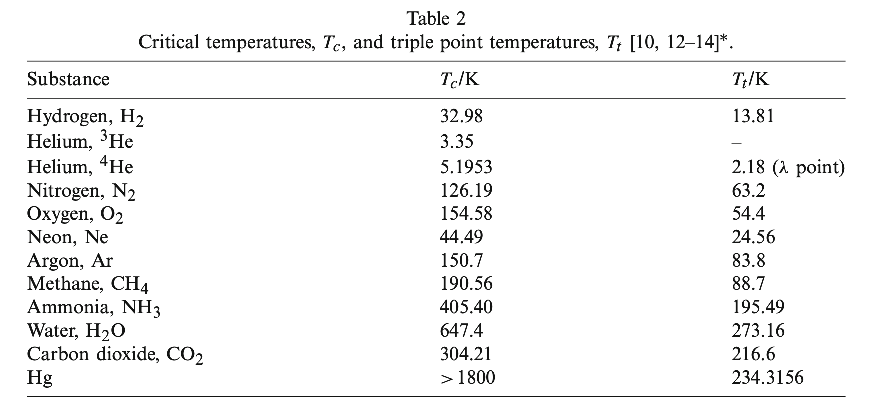

Every gas has its own critical temperature
$$T_{3}/K$$
From Berberberan-Santos et al, 2008

Slide 10

Every gas has its own critical temperature
$$T_{3}/K$$
From Berberberan-Santos et al, 2008
H₂ molecules are not very sticky, so it’s hard to liquify H₂ gas
=> H₂ has a really low critical temperature.

Slide 11
Every gas has its own critical temperature
$$T_{3}/K$$
From Berberberan-Santos et al, 2008
H₂O and NH₃ molecules are very sticky (they have hydrogen bonding!) so it’s easy to liquify them.
=> H₂O and NH₃ have a really high critical temperature.

Slide 12
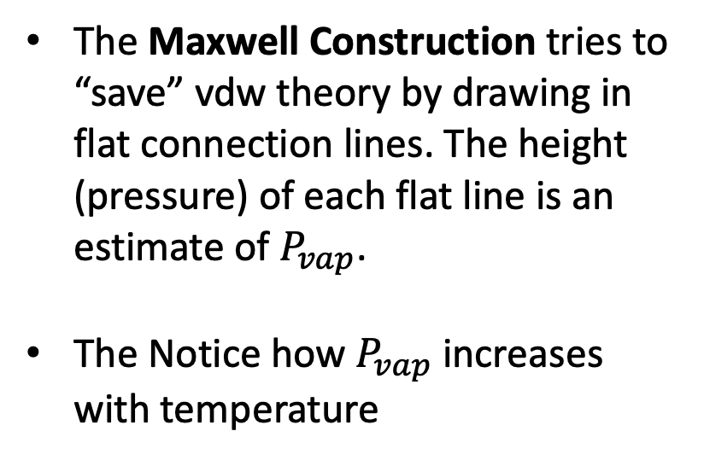
Maxwell tried to “save” van der Waals theory at temperature below $T_{c}$
The Maxwell Construction tries to “save” vdw theory by drawing in flat connection lines. The height (pressure) of each flat line is an estimate of $P_{vap}$.
The Notice how $P_{vap}$ increases with temperature

Slide 13
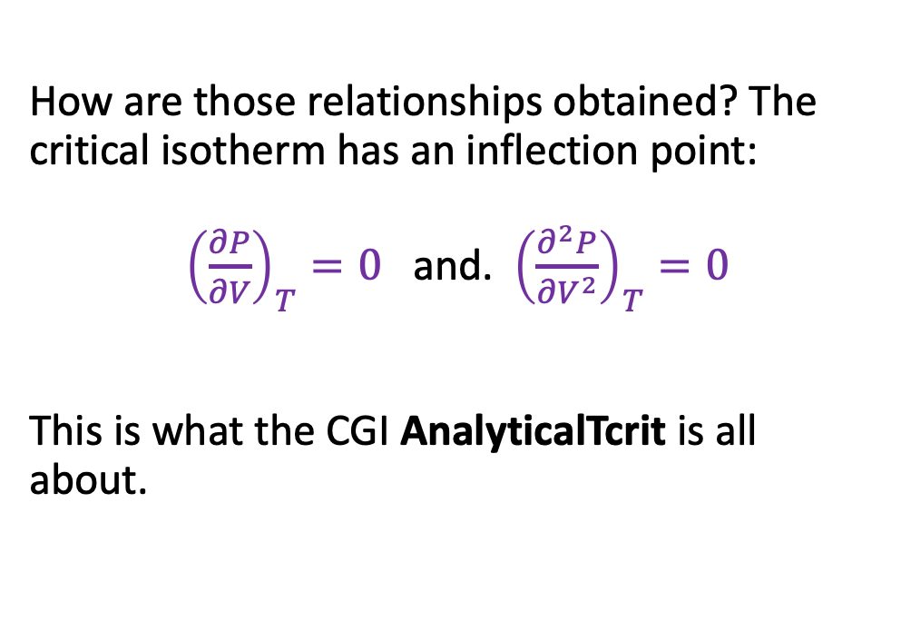
Getting 𝑻_{𝒄rit} and 𝑽_{𝒄rit} from a and b
How are those relationships obtained? The critical isotherm has an inflection point:
${\left(\frac{∂P}{∂V}\right)}_{T}=0$ and. ${\left(\frac{∂^{2}P}{∂V^{2}}\right)}_{T}=0$
This is what the CGI AnalyticalTcrit is all about.

Slide 14
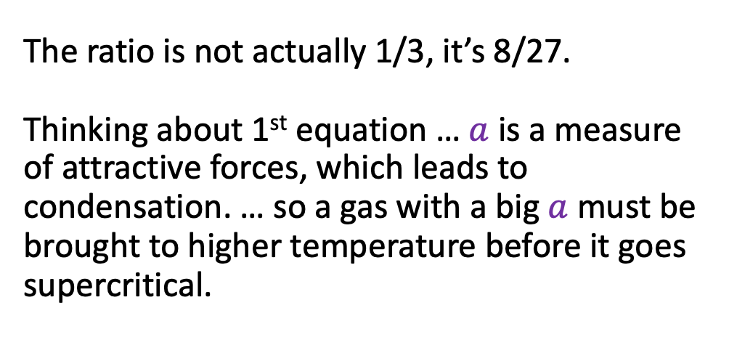
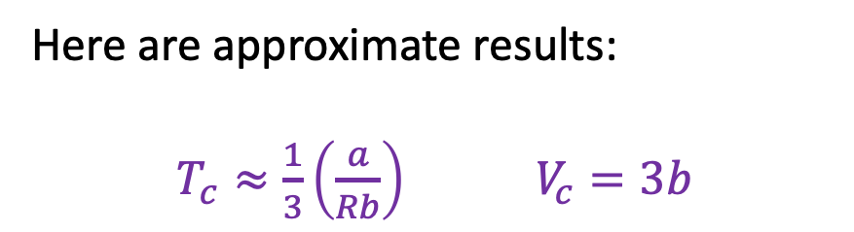
Analytical properties of vdw’s equation
Here are approximate results:
$T_{c}≈\frac{1}{3}\left(\frac{a}{Rb}\right)$ $V_{c}=3b$
The ratio is not actually 1/3, it’s 8/27.
Thinking about 1st equation … $a$ is a measure of attractive forces, which leads to condensation. … so a gas with a big $a$ must be brought to higher temperature before it goes supercritical.

Slide 15
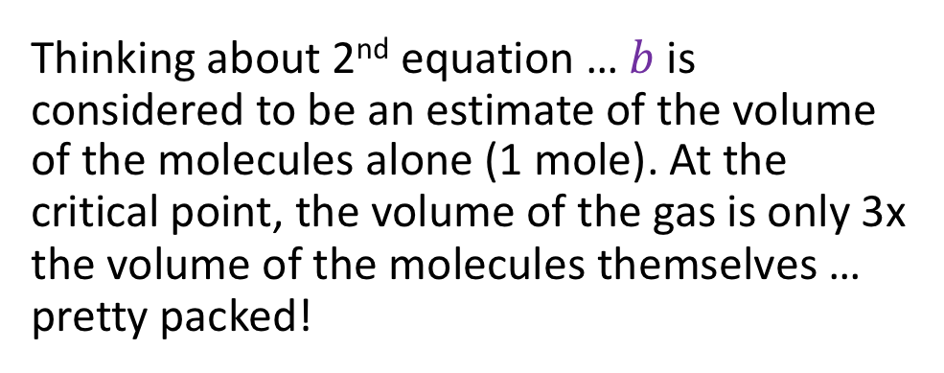
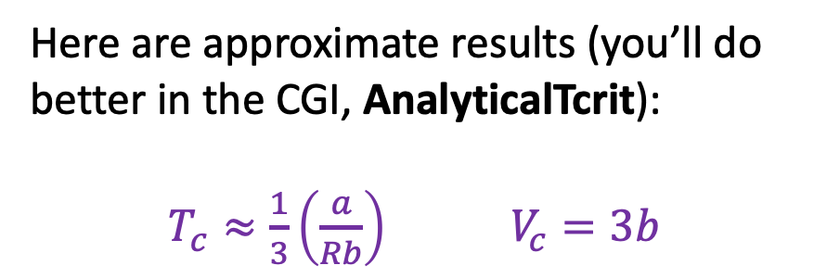
Analytical properties of vdw’s equation
Here are approximate results (you’ll do better in the CGI, AnalyticalTcrit):
$T_{c}≈\frac{1}{3}\left(\frac{a}{Rb}\right)$ $V_{c}=3b$
Thinking about 2nd equation … $b$is considered to be an estimate of the volume of the molecules alone (1 mole). At the critical point, the volume of the gas is only 3x the volume of the molecules themselves … pretty packed!

Slide 16
What we learned …
The Principle of Corresponding States
Isothermal compression of a gas above the critical temperature is quite different from compression below the critical temperature
Critical values can be derived from vdw’s “a” and “b” coefficients

